Slide 1

ESRF User Meeting 2026
PyFAI tutorial
Jérôme Kieffer
Edgar Gutiérrez Fernández
02/02/2026

Slide 2
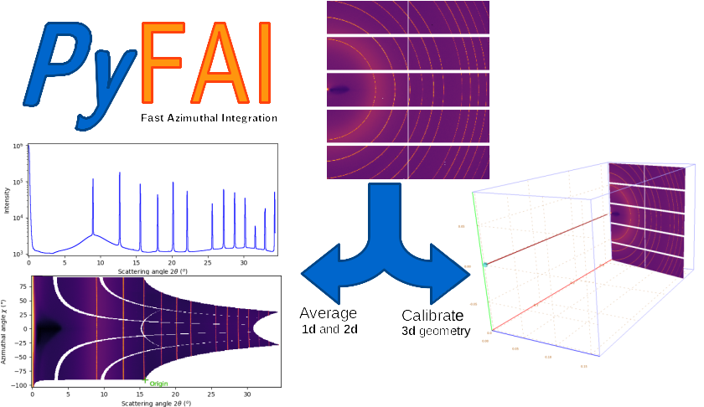
PyFAI tutorial - overview
02/02/2026 / 14:00 – 16:30
Each user should use its own computer (Windows, Linuc, MacOS)
1st half: concepts of pyFAI
  Motivations
  Applications
  Working philosophy
Coffee break (~15 minutes)
2nd half: hands-on
  Installation of python: venv/conda/visa
  Installation of pyFAI
  Calibration GUI
  AzimuthalIntegratrion
  Other pyFAI applications: integrate, diffmap-view, worker…

Slide 3
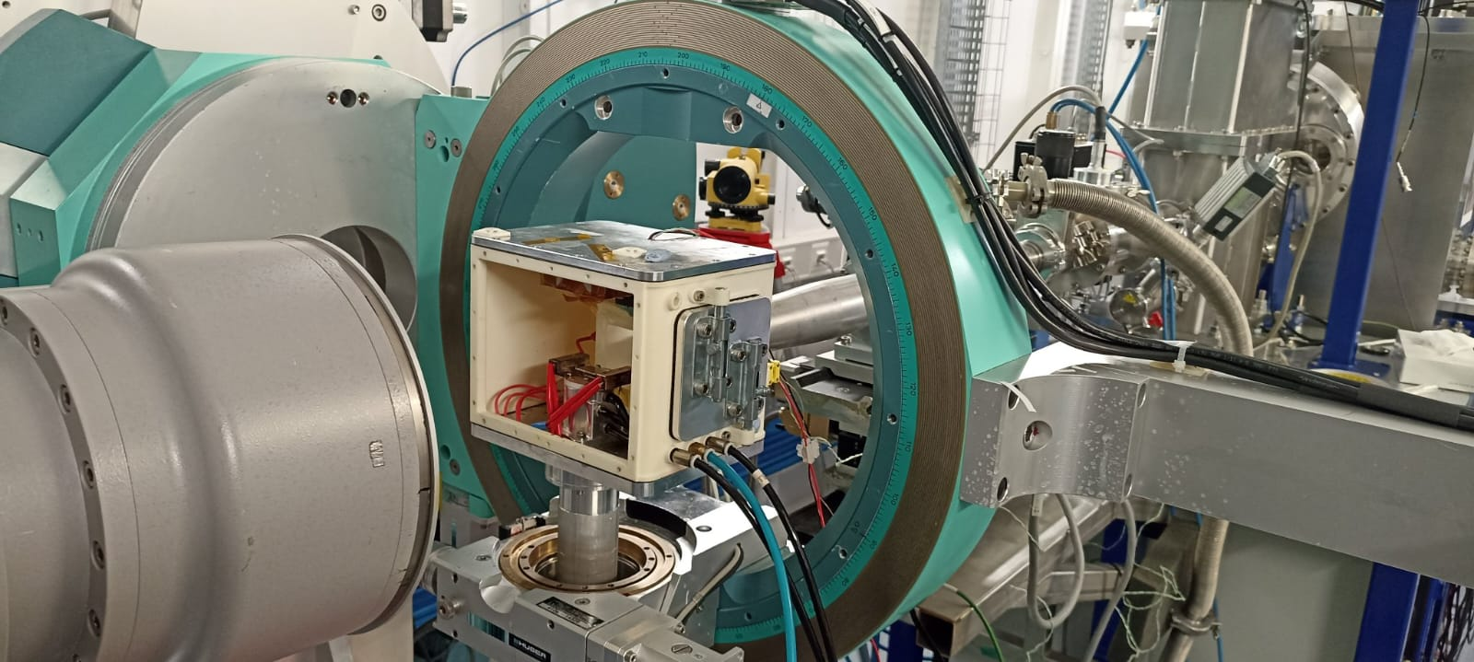
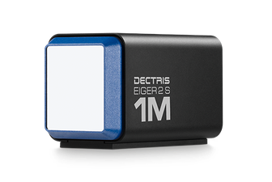
PyFAI = Python Fast Azimuthal Integrator
*BM28
Setup experiment
Data collection
Data reduction
Data analysis

Slide 4
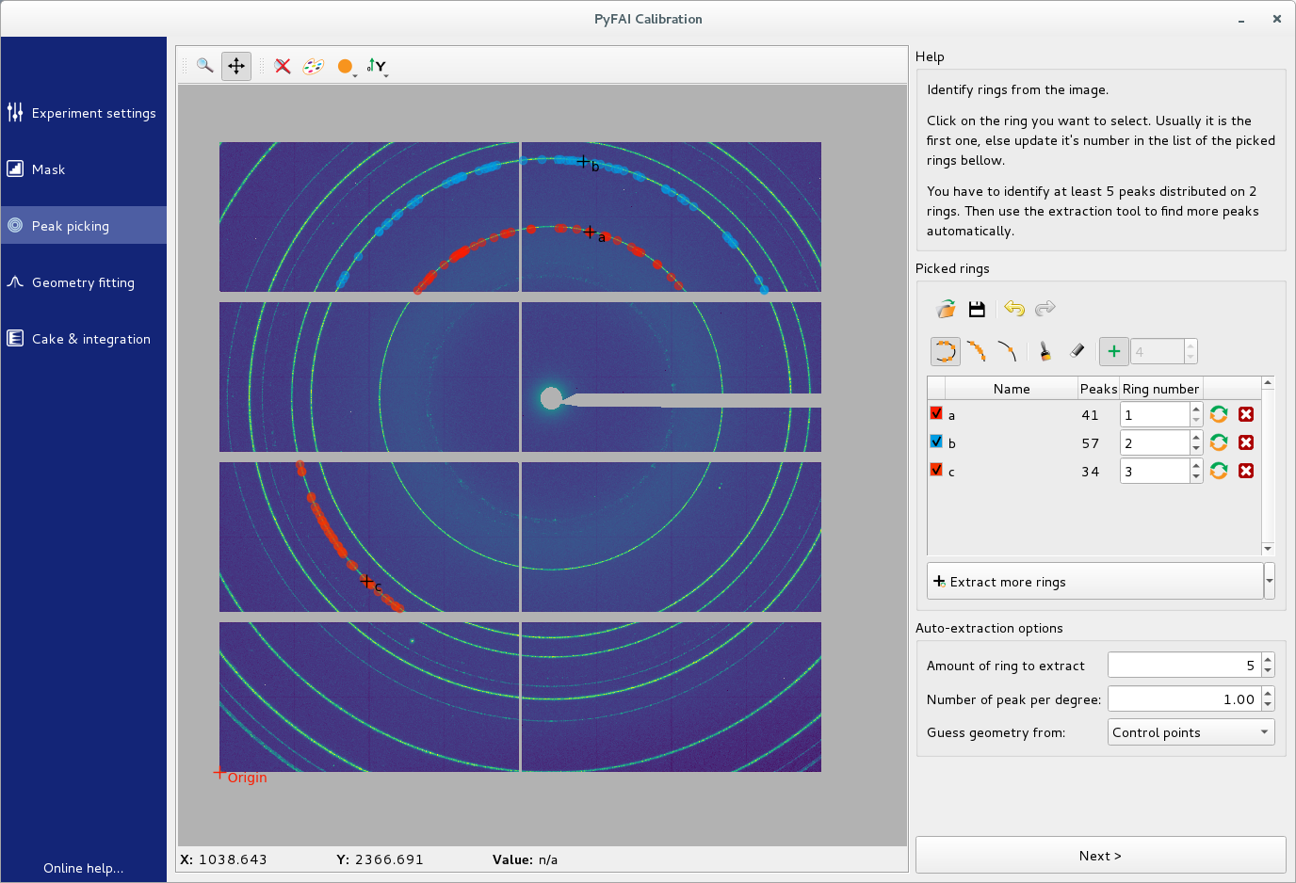
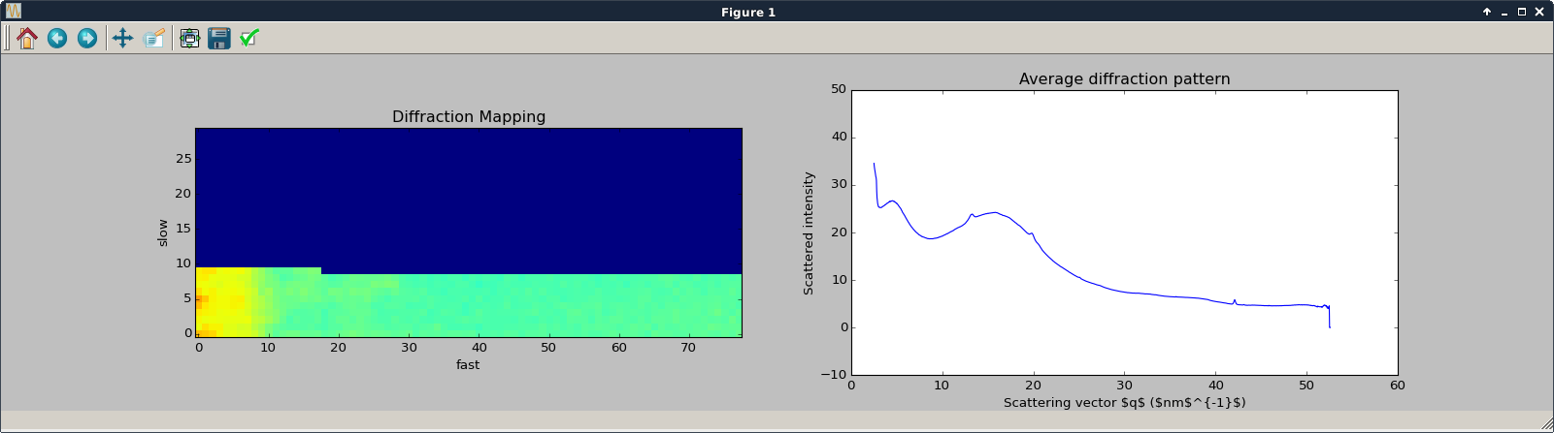
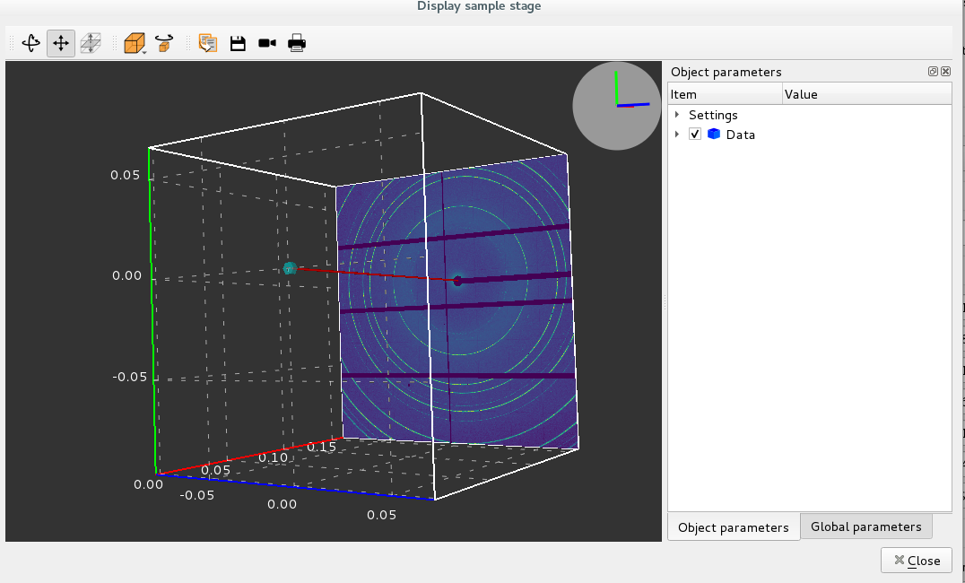
PyFAI = Python Fast Azimuthal Integrator
Calibration
*BM28
Diffraction mapping
Setup experiment
Data collection
Data reduction
3D geometry

Slide 5
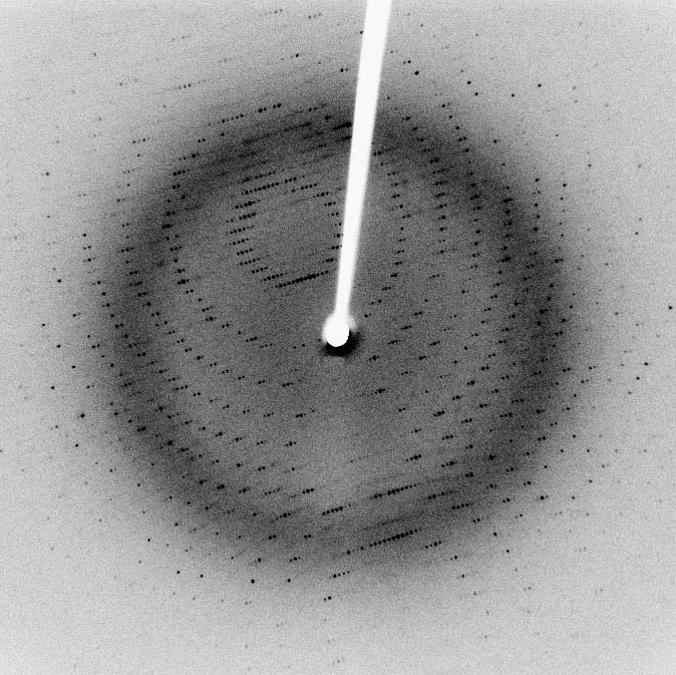
X-ray scattering techniques
Scattering is the deflection of photons upon interaction with matter.
Source: Wikipedia
CC-BY-SA: Jeff Dahl
Bragg spots: diffraction from single crystal
X ray
Monochromatic
Sample
2D camera
Debye-Scherrer ring: diffraction from polycrystals
Elastic scattering
E_{inc} = E_{scat}
ΔE=0
Monochromatic beam
Δλ≈0
2-Dimensional detectors
Shape = (x,y)

Slide 6
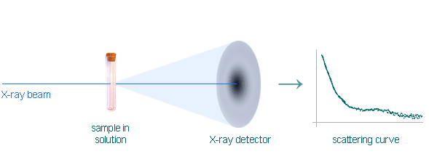
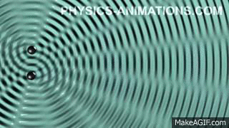

X-ray scattering techniques: diffraction / scattering
If the material is crystalline, the scattered photons create constructive interferences, like water waves.
Constructive interference between scattered X-ray takes place if Bragg relation is fulfilled:
$$nλ=2d\sin{θ}$$
If the material is disordered, the scattered photons create broad distributions of intensity.
More ambiguous and hard to analyze. Usually requires complementary techniques.
https://biosaxs.com/technique.html

Slide 7
X-ray scattering techniques: diffraction / scattering
The study of highly crystalline materials (metals, ceramics, oxides…) is named ‘diffraction’’.
Powder Diffraction: isotropic
  Phase identification
  Crystallinity
  Lattice parameters
  Thermal expansion
  Phase transition
  Strain/crystallite size
The study of largely/inherently disordered materials (polymers, proteins, colloids…) is named ‘scattering’’.
Wide-Angle X-ray Scattering (WAXS): analog to diffraction:
  Phase identification
  Crystalllinity/orientation
Small-Angle X-ray Scattering (SAXS): micro/nano scale prove:
  Particle shape/surface
  Proteins domains
  Protein folding
  Colloid parameters
  Fiber orientation

Slide 8
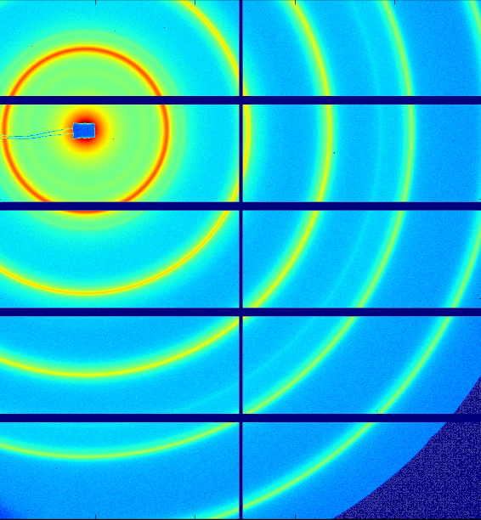
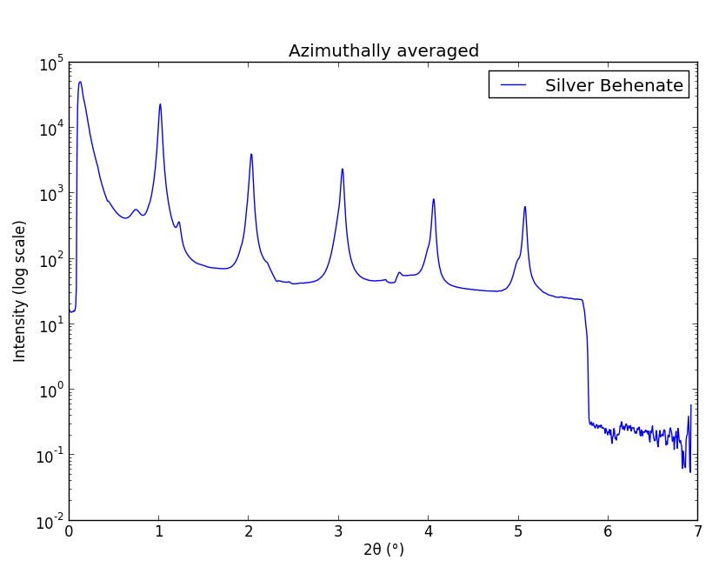
X-ray scattering techniques: diffraction / scattering
The study of highly crystalline materials (metals, ceramics, oxides…) is named ‘diffraction’’.
Powder Diffraction: isotropic
The study of largely/inherently disordered materials (polymers, proteins, colloids…) is named ‘scattering’’.
WAXS: analog to diffraction.
SAXS: micro/nano scale prove.
Both rely on the same transformation: 2D image to azimuthal average.
PyFAI is the first tool to be used after data acquisition.

Slide 9
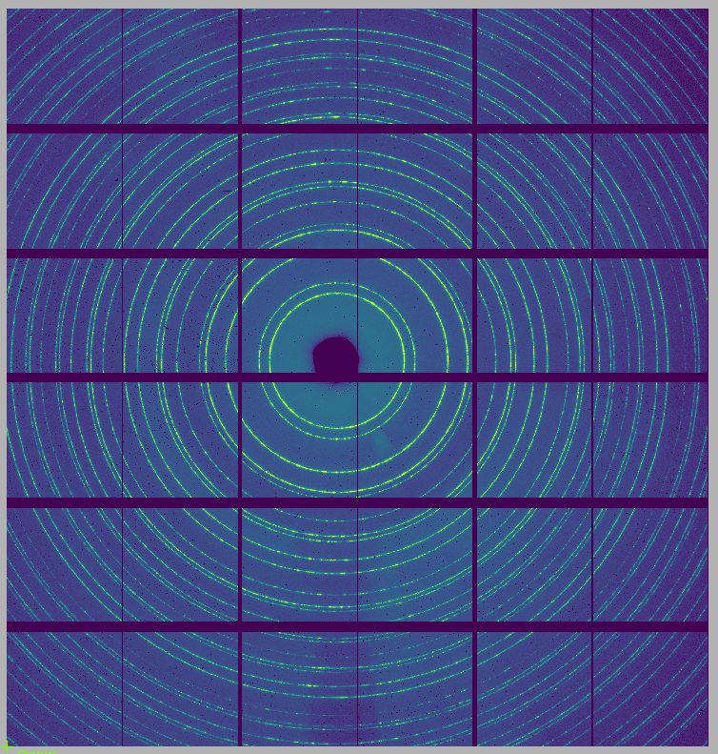
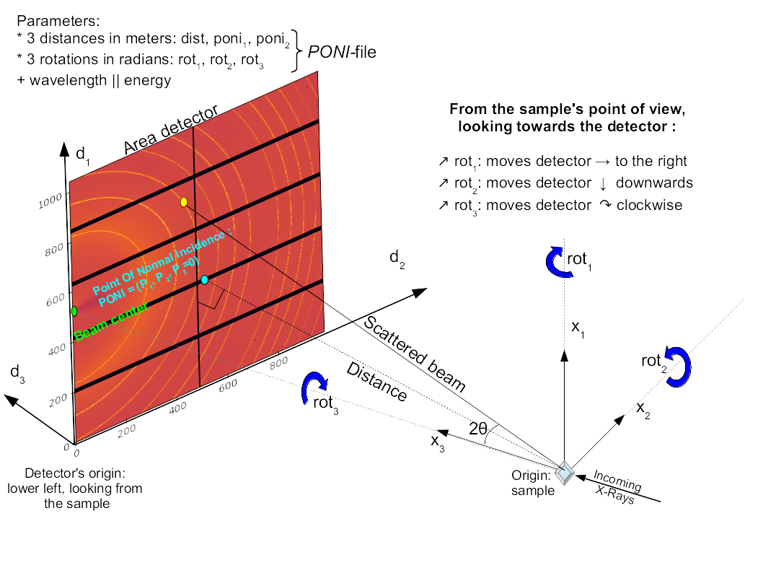

PyFAI: core concepts
Detector
detector_factory
Generic detector
Image / Frame / Pattern
Numpy 2D array
To be read using FabIO,
silx, h5py…
Geometry
X-ray wavelength
Position and rotations
of the detector
Integrator
Takes the detector and geometry
Takes the image
Performs the integration

Slide 10
PyFAI: core concepts
Detector
detector_factory
Generic detector
Image / Frame / Pattern
Numpy 2D array
To be read using FabIO,
silx, h5py…
Geometry
X-ray wavelength
Position and rotations
of the detector
Integrator
Takes the detector and geometry
Takes the image
Performs the integration

Slide 11
PyFAI: core concepts
Detector
detector_factory
Generic detector
Image / Frame / Pattern
Numpy 2D array
To be read using FabIO,
silx, h5py…
Geometry
X-ray wavelength
Position and rotations
of the detector
Integrator
Takes the detector and geometry
Takes the image
Performs the integration

Slide 12
PyFAI: core concepts
Detector
detector_factory
Generic detector
Image / Frame / Pattern
Numpy 2D array
To be read using FabIO,
silx, h5py…
Geometry
X-ray wavelength
Position and rotations
of the detector
Integrator
Takes the detector and geometry
Takes the image
Performs the integration

Slide 13
PyFAI: core concepts
Detector
detector_factory
Generic detector
Image / Frame / Pattern
Numpy 2D array
To be read using FabIO,
silx, h5py…
Geometry
X-ray wavelength
Position and rotations
of the detector
Integrator
Takes the detector and geometry
Takes the image
Performs the integration

Slide 14
Geometry instance
A geometry is fully defined by:
  A detector instance
  Sample to detector distance (in meters)
  Wavelength of the beam (in meters)
  Three rotations of the detector
  Coordinates of the point of normal incidence (PONI), from the sample to the detector plane.
Normally, the calibration of the geometry is fully done through the graphical interface.

Slide 15

Calibration of geometry: pyFAI-calib2
Calibration is made after measuring a standard sample:
  LaB6, Cr2O3, AgBh…
Choosing the correct detector (+ orientation, binning, mask…)
Selecting the Debye-Scherrer rings associated to the standard
Fitting the rings
Refinement
Validation
Saving of .poni file
.poni file

Slide 16
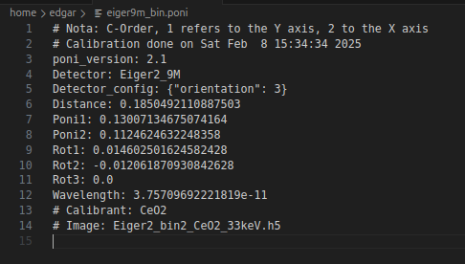
Calibration of geometry: pyFAI-calib2
Calibration is made after measuring a standard sample:
  LaB6, Cr2O3, AgBh…
Choosing the correct detector (+ orientation, binning, mask…)
Selecting the Debye-Scherrer rings associated to the standard
Fitting the rings
Refinement
Validation
Saving of .poni file
.poni file

Slide 17
PyFAI: creating an integrator
Integrator
Detector
Geometry

Slide 18
PyFAI: creating an integrator
Integrator

Slide 19
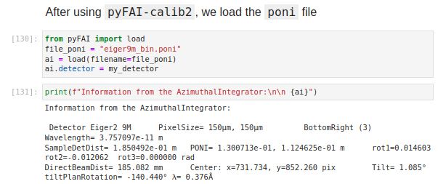
PyFAI: creating an integrator
Integrator

Slide 20
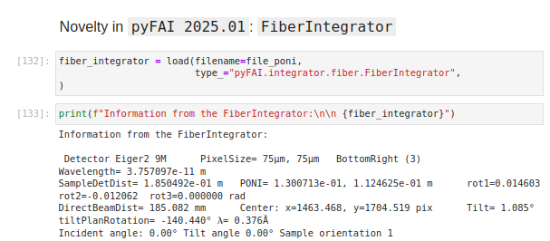
PyFAI: creating an integrator
Integrator
*FiberIntegrator is targeted to Grazing Incidence experiments

Slide 21
PyFAI: loading data
Integrator
RAW DATA

Slide 22
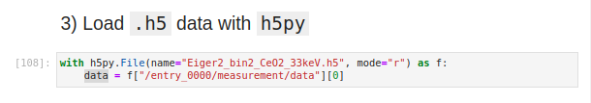
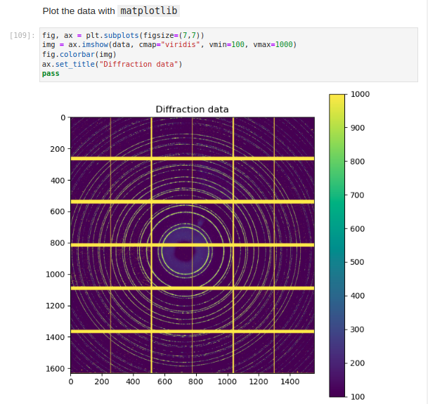
PyFAI: loading data
Importing data is made through other python packages:
  FabIO
  Silx
  h5py
Common file formats:
  .edf
  .tiff
  .h5
Visualizing is made through:
  matplotlib
  seaborn
  silx

Slide 23
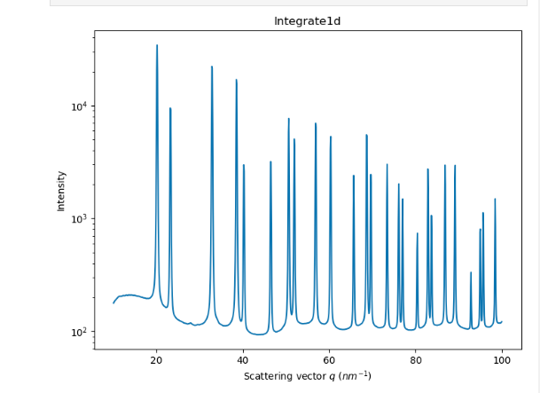
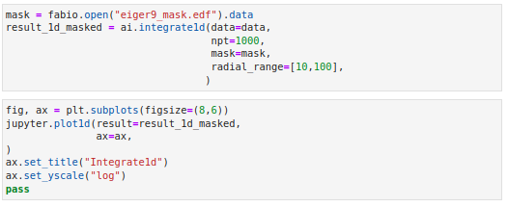
PyFAI: loading data
RAW DATA
integrate1d
Integrator

Slide 24
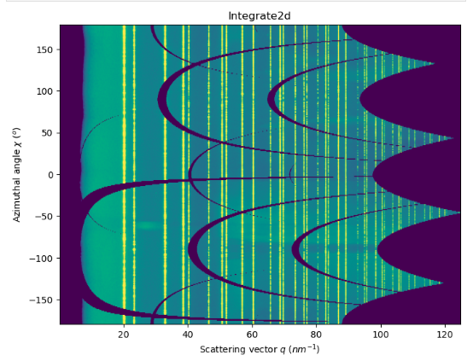
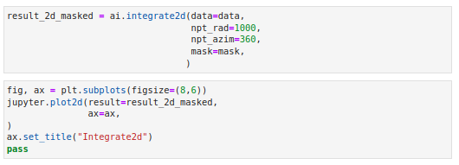
PyFAI: loading data
RAW DATA
integrate2d
Integrator

Slide 25
What happens during an integration
1) Get the coordinates of every corner of every pixel of the detector (in meters).
  3 coordinates per corner, 4 corners per pixel
  Detector of 1000x1000 = 10⁶ pixels = 1Mpix * 4 (corners) * 3 (coordinates) * 4 (bytes) = 48 Mbytes
2) Offset the detector’s origin to the PONI and rotate around the sample.
3) Calculate the radial (2theta) and azimuthal (chi) positions of each corner.
4) Calculate normalization matrix: polarization, solid-angle, flat-field...
5) Assign each pixel to one or multiple bins.
6) Histogram bin position with associated intensities
7) Histogram bin position with associated normalizations
8) Return bin position and the ratio of sum of intensities / sum of norm.

Slide 26

Integration algorithms
Histogram
  Pixel by pixel procedure.
  Each pixel is split over the bins it covers.
  Corner coordinates have to be calculated (4x slower initialization).
  The slow down is function of the oversampling factor, for every image.
  Serial read → Random write
Sparse Matrix Multiplication
  Bin by bin procedure.
  Creates and stores a sparse matrix with all the integration information.
  The sparse matrix can be huge: longer initialization related to the oversampling factor.
  No performance penalty on the integration itself.
  Serial write ← Random read

Slide 27
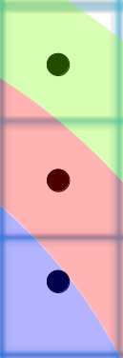

Pixel splitting
No splitting: one pixel to one single bin upon in which bin the center of the pixel is falling.
Bin (k+1)
Bin (k)
Bin (k-1)
The intensity of each bin is the sum of the intensity of the pixels whose center falls into the radius bin

Slide 28
Pixel splitting
Splitting: each pixel intensity is shared between consecutive bins.
*Full pixel splitting
Bin (k+1)
Bin (k)
Bin (k-1)
Each bin is the sum of the intensities of different pixels multiplied by a weight between 0.0 and 1.0

Slide 29




Implementation
Python
Use numpy methods
No initialization
Slow, no cache
Non-recommended (not popular)
Cython
Use cython methods
No initialization
Faster than python, no cache
Recommended to integrate 10s frames
OpenCL
Use parallelization through CPU/GPU
Initialization ~1-3 s
Cache
Potentially fast, depending on the GPU
Best option for large data

Slide 30
pyFAI interfaces
Applications:
  GUI applications: pyFAI-calib2, pyFAI-integrate, pyFAI-diffmap-view
  Batch mode: worker
  Scriptable applications: pyFAI-average, pyFAI-saxs, pyFAI-waxs, diff_tomo
Python interface:
  High level, direct API: scripts, Jupyter notebook
  Mid level: manually creation of detectors, integrators, units…
  Low level: manually setting the integrator engines
It is up to the user to choose the way he/she uses pyFAI

Slide 31
Latest news from pyFAI
pyFAI-2025.12.1
Parallax correction API
  Absorption coefficients of detector materials
  Detector thickness
Improved module for crystallography
Grazing Incidence integration on pyFAI-integrate
Arithmetic operations of containers
GUI bugs fixed

Slide 32
Reasons to choose pyFAI
Faster than others
  First tool using sparse matrix multiplication to perform integration
  All computation intensive kernels are ported to C, C++ or OpenCL
  PyFAI is the only azimuthal integration tool benefiting from GPU
Versatile (increasing with every version)
  Wide space to vary the integration protocol
  Generic geometry
  Most detectors already defined (+ custom detector through Nexus file)
  Graphical user interface alternatives (thanks to Valentin Valls)

Slide 33
Acknowledgements
Main author: Jerome Kieffer
Contributors: 43
Former data analysis unit colleagues:
  Valentin Valls
  Loic Huder
  Thomas Vincent
  Claudio Ferrero
ESRF Beamlines:
  BM01, BM02, ID02, ID11, ID13, ID15a, ID15b, ID21, ID22, ID23, BM26, ID27, BM28, ID28, BM29, ID29, ID30, ID31...
Trainees:
  Aurore Deschildre
  Frederic Sulzmann
  Guillaume Bonamis
Other synchrotron/labs
  Soleil: Fred Picca
  Clemens Prescher (Dioptas)
  Sesame: Philipp Hans
  NSLS-II, ALS, APS…
International Grants:
  LinkSCEEM-2 grant:
    Dimitris Karkoulis
    Giannis Ashiotis
    Zubair Nawaz

Slide 34
ESRF User Meeting 2026
PyFAI tutorial
Jérôme Kieffer
Edgar Gutiérrez Fernández
02/02/2026

