Slide 1

ESRF User Meeting 2026 PyFAI tutorial – Grazing Incidence
Jérôme Kieffer
Edgar Gutiérrez Fernández
02/02/2026
Download the resources:
git clone https://gitlab.esrf.fr/edgargf/pyfai_tutorial.git

Slide 2
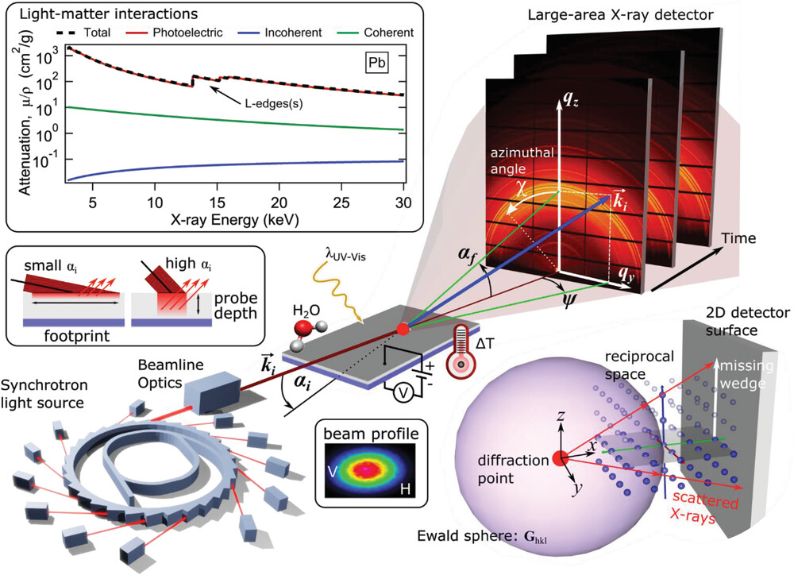
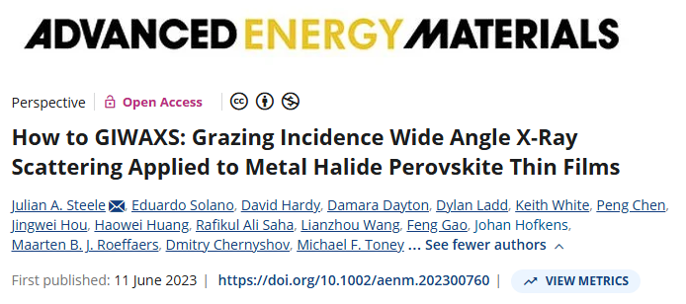
PyFAI tutorial - overview
02/02/2026 / 09:00 – 11:30
Each user should use its own computer (Windows, Linuc, MacOS)
1st third: data spottiness
2nd third: grazing incidence
3rd third: parallax effect
git clone https://gitlab.esrf.fr/edgargf/pyfai_tutorial.git

Slide 3
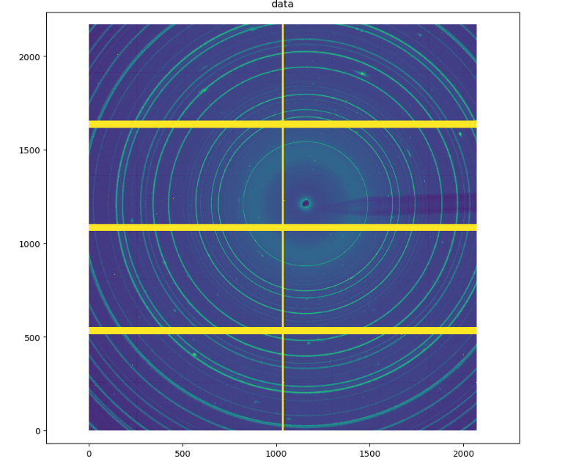
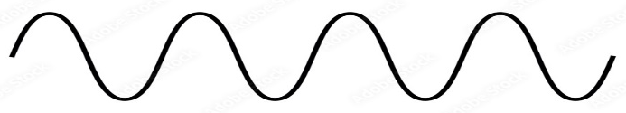

Fiber / Grazing Incidence experiments
Transmission / Grazing scattering
Capillary
Scattered cone
X-ray beam
Probed length ~ mm
2D-Detector
git clone https://gitlab.esrf.fr/edgargf/pyfai_tutorial.git

Slide 4
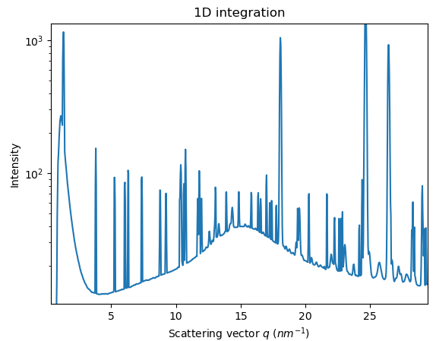
Fiber / Grazing Incidence experiments
Transmission / Grazing scattering
Capillary
Scattered cone
X-ray beam
Probed length ~ mm
2D-Detector
git clone https://gitlab.esrf.fr/edgargf/pyfai_tutorial.git

Slide 5
Fiber / Grazing Incidence experiments
Transmission / Grazing scattering
Thin film
Substrate
Scattered cone
X-ray beam
Probed length ~ nm
2D-Detector
git clone https://gitlab.esrf.fr/edgargf/pyfai_tutorial.git

Slide 6
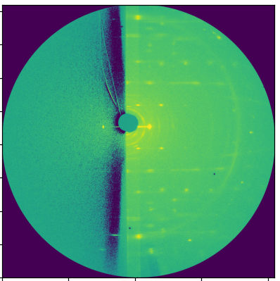

Fiber / Grazing Incidence experiments
Transmission / Grazing scattering
X-ray beam
Thin film
Scattered cone
Substrate
2D-Detector
$$α_{c}= \sqrt{δ(λ)}$$
git clone https://gitlab.esrf.fr/edgargf/pyfai_tutorial.git

Slide 7
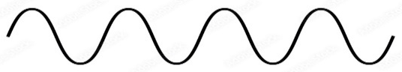













Powder / Grazing-incidence analysis
Transmission
Powder (classic) analysis
Intensity as a function of q-modulus
Grazing-Incidence
Quasi-powder analysis
q is split in two components
Out-of-plane is the vertical axis (fiber), normal to the film surface
In-plane is the averaged axis of the film surface plane
$$\vec{k_{i}}$$
$$\vec{k_{f}}$$
X-ray beam
$$\vec{k_{f}}$$
$$\vec{q_{z}}$$
$$\vec{q}$$
$$2θ$$
$$\vec{k_{i}}$$
$$\vec{q_{x}}$$
$$\vec{q_{y}}$$
$$\vec{q}= \vec{k_{f}} − \vec{k_{i}} ; q= \frac{4π}{λ}\sin{θ}$$
$$q_{IP}= \sqrt{{q_{x}}^{2}+ {q_{y}}^{2}}$$
$I\left(q\right) ; I(χ, q)$
$$q_{OOP}= q_{z}$$
git clone https://gitlab.esrf.fr/edgargf/pyfai_tutorial.git

Slide 8
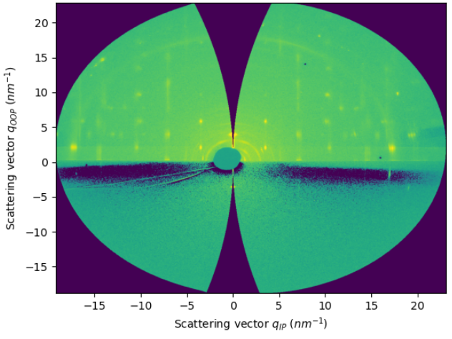
Powder / Grazing-incidence analysis
Transmission
Powder (classic) analysis
Intensity as a function of q-modulus
Grazing-Incidence
Quasi-powder analysis
q is split in two components
Out-of-plane is the vertical axis (fiber), normal to the film surface
In-plane is the averaged axis of the film surface plane
$$\vec{k_{i}}$$
$$\vec{k_{f}}$$
X-ray beam
$$\vec{k_{f}}$$
$$\vec{q}$$
$$2θ$$
$$\vec{k_{i}}$$
$$\vec{q}= \vec{k_{f}} − \vec{k_{i}} ; q= \frac{4π}{λ}\sin{θ}$$
$$q_{IP}= \sqrt{{q_{x}}^{2}+ {q_{y}}^{2}}$$
$I\left(q\right) ; I(χ, q)$
$$q_{OOP}= q_{z}$$
git clone https://gitlab.esrf.fr/edgargf/pyfai_tutorial.git

Slide 9



class FiberIntegrator
FiberIntegrator class
Inherits methods from AzimuthalIntegrator
Introduces methods for grazing-incidence data reduction
integrate1d_fiber = integrate1d_grazing_incidence
integrate1d_polar
integrate1d_exitangles
integrate2d_fiber = integrate2d_grazing_incidence
integrate2d_polar
integrate2d_exitangles
Introduces three integration parameters
Incident angle
Tilt angle
Sample orientation (8 possibilities)
$$\vec{q_{z}}$$
Incidence
$$\vec{q_{x}}$$
$$\vec{q_{y}}$$
X-ray beam
Tilt

Slide 10
ESRF User Meeting 2026 PyFAI tutorial
Jérôme Kieffer
Edgar Gutiérrez Fernández
02/02/2026
git clone https://gitlab.esrf.fr/edgargf/pyfai_tutorial.git

