Slide 1
ESRF User Meeting 2025 PyFAI tutorial
Jérôme Kieffer
Edgar Gutiérrez Fernández
10/02/2025

Slide 2
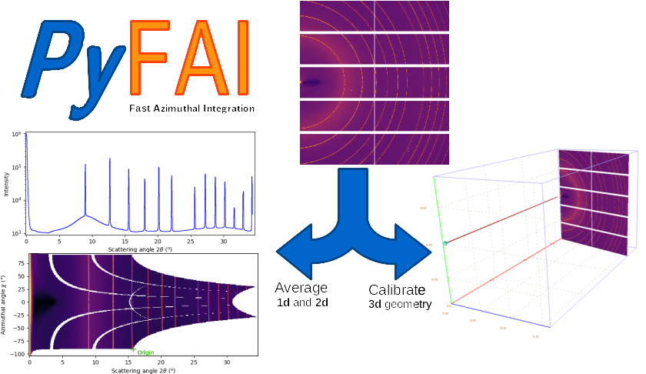
PyFAI tutorial - overview
10/02/2025 / 14:00 – 17:00
Each user should use its own computer (Windows, Linuc, MacOS)
1st half: concepts of pyFAI
Motivations
Applications
Working philosophy
Coffee break (~15 minutes)
2nd half: hands-on
Installation of python: venv/conda/visa
Installation of pyFAI
Calibration GUI
AzimuthalIntegratrion
Other pyFAI applications: integrate, diffmap-view, worker…

Slide 3
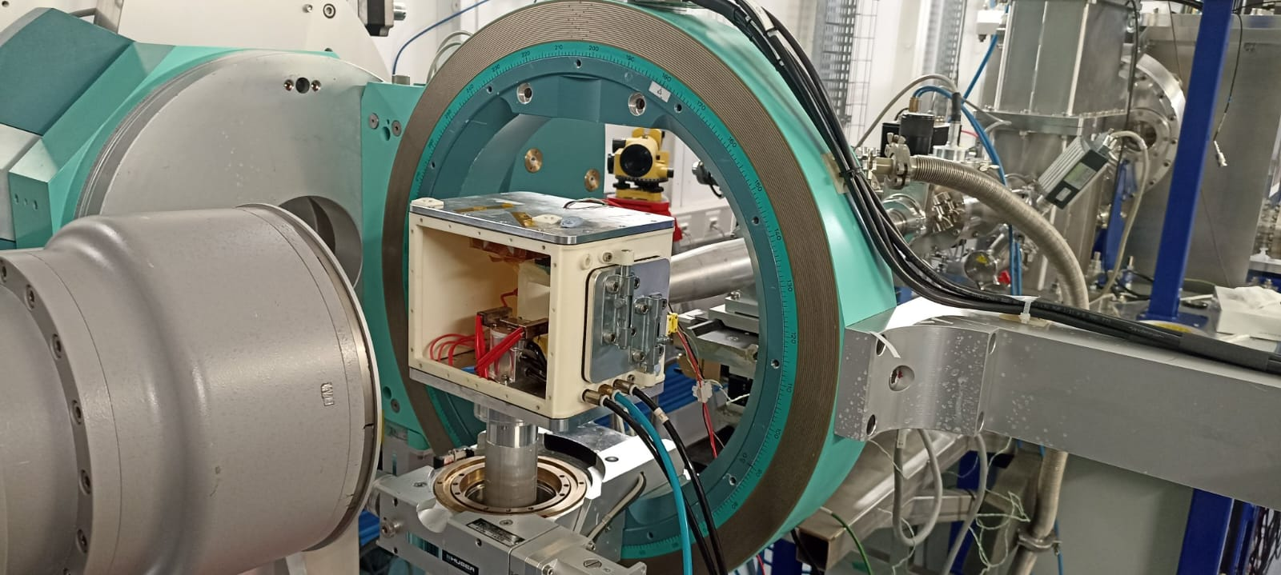
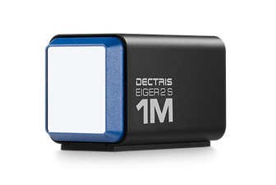
PyFAI = Python Fast Azimuthal Integrator
*BM28
Setup experiment
Data collection
Data reduction
Data analysis

Slide 4
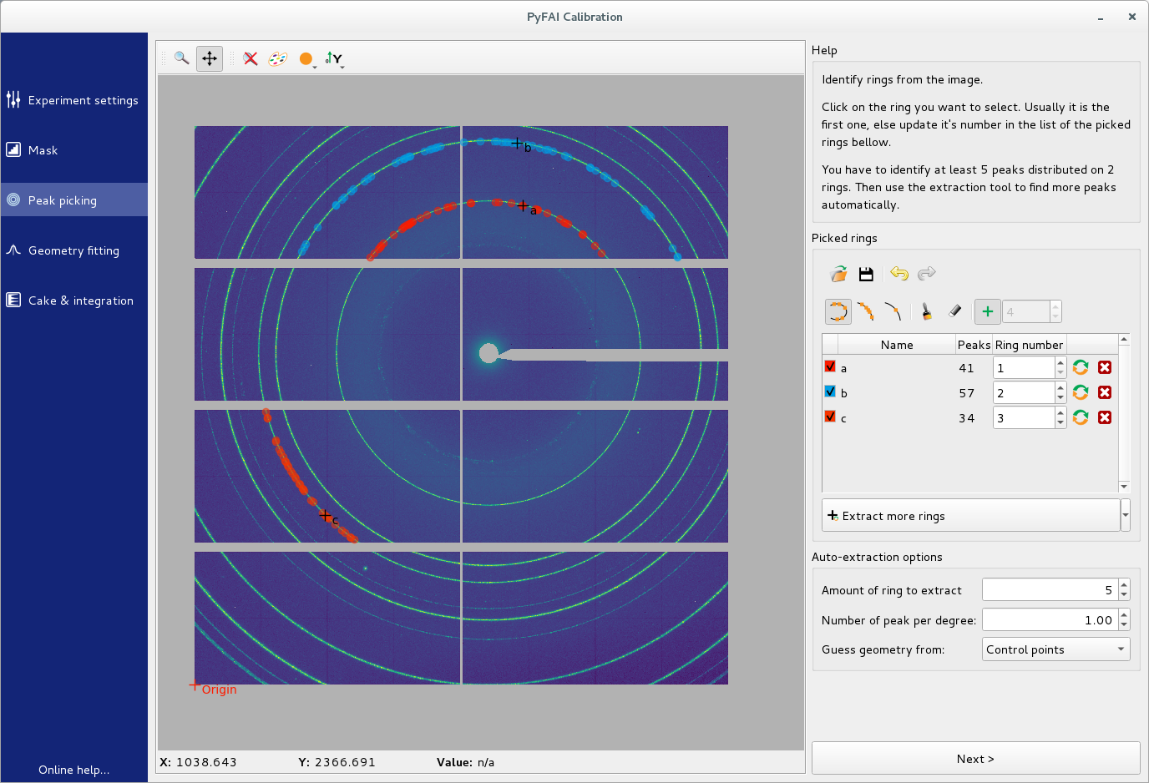
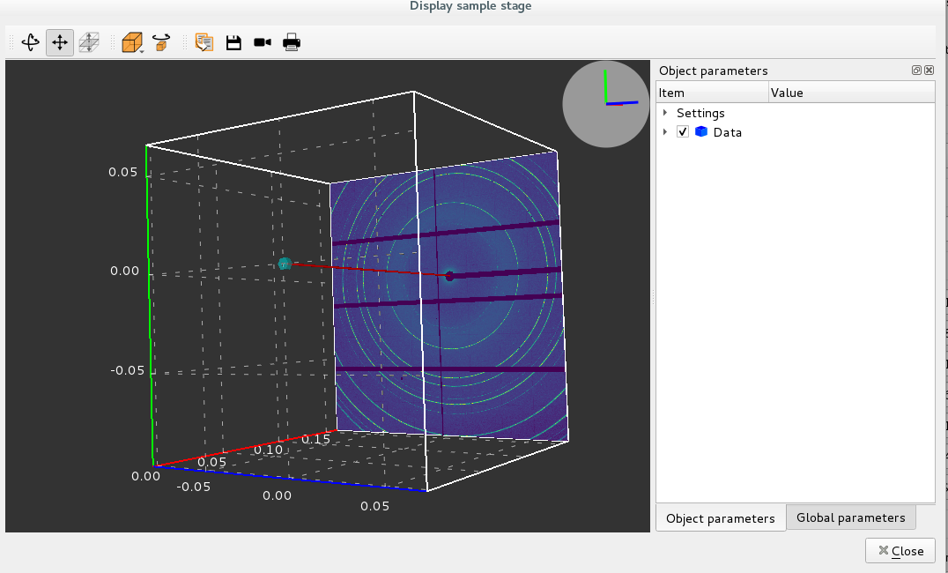
PyFAI = Python Fast Azimuthal Integrator
Calibration
*BM28
Diffraction mapping
Setup experiment
Data collection
Data reduction
3D geometry

Slide 5
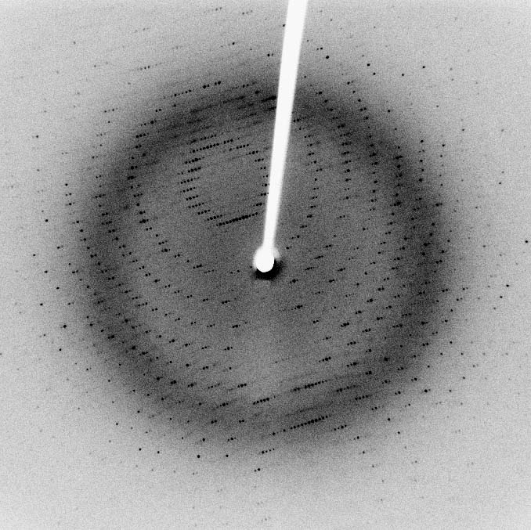
X-ray scattering techniques
Scattering is the deflection of photons upon interaction with matter.
Source: Wikipedia
CC-BY-SA: Jeff Dahl
Bragg spots: diffraction from single crystal
X ray
Monochromatic
Sample
2D camera
Debye-Scherrer ring: diffraction from polycrystals
Elastic scattering
E_{inc} = E_{scat}
ΔE=0
Monochromatic beam
Δλ≈0
2-Dimensional detectors
Shape = (x,y)

Slide 6
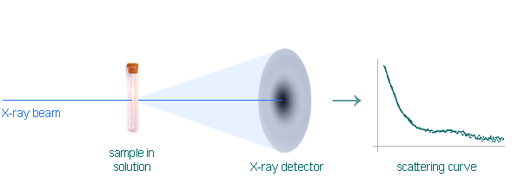
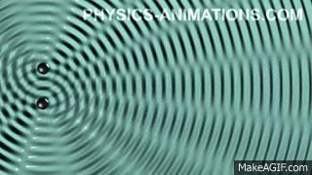
X-ray scattering techniques: diffraction / scattering
If the material is crystalline, the scattered photons create constructive interferences, like water waves.
Constructive interference between scattered X-ray takes place if Bragg relation is fulfilled:
$$nλ=2d\sin{θ}$$
If the material is disordered, the scattered photons create broad distributions of intensity.
More ambiguous and hard to analyze. Usually requires complementary techniques.
https://biosaxs.com/technique.html

Slide 7
X-ray scattering techniques: diffraction / scattering
The study of highly crystalline materials (metals, ceramics, oxides…) is named ‘diffraction’’.
Powder Diffraction: isotropic
Phase identification
Crystallinity
Lattice parameters
Thermal expansion
Phase transition
Strain/crystallite size
The study of largely/inherently disordered materials (polymers, proteins, colloids…) is named ‘scattering’’.
Wide-Angle X-ray Scattering (WAXS): analog to diffraction:
Phase identification
Crystalllinity/orientation
Small-Angle X-ray Scattering (SAXS): micro/nano scale prove:
Particle shape/surface
Proteins domains
Protein folding
Colloid parameters
Fiber orientation

Slide 8
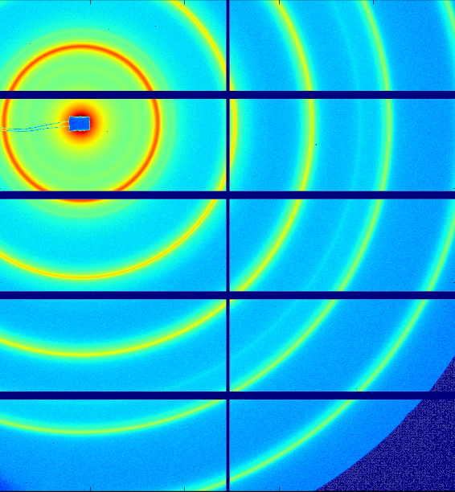
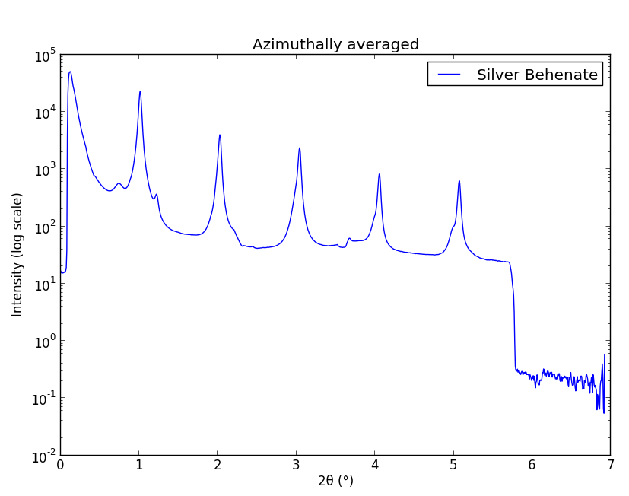
X-ray scattering techniques: diffraction / scattering
The study of highly crystalline materials (metals, ceramics, oxides…) is named ‘diffraction’’.
Powder Diffraction: isotropic
The study of largely/inherently disordered materials (polymers, proteins, colloids…) is named ‘scattering’’.
WAXS: analog to diffraction.
SAXS: micro/nano scale prove.
Both rely on the same transformation: 2D image to azimuthal average.
PyFAI is the first tool to be used after data acquisition.

Slide 9
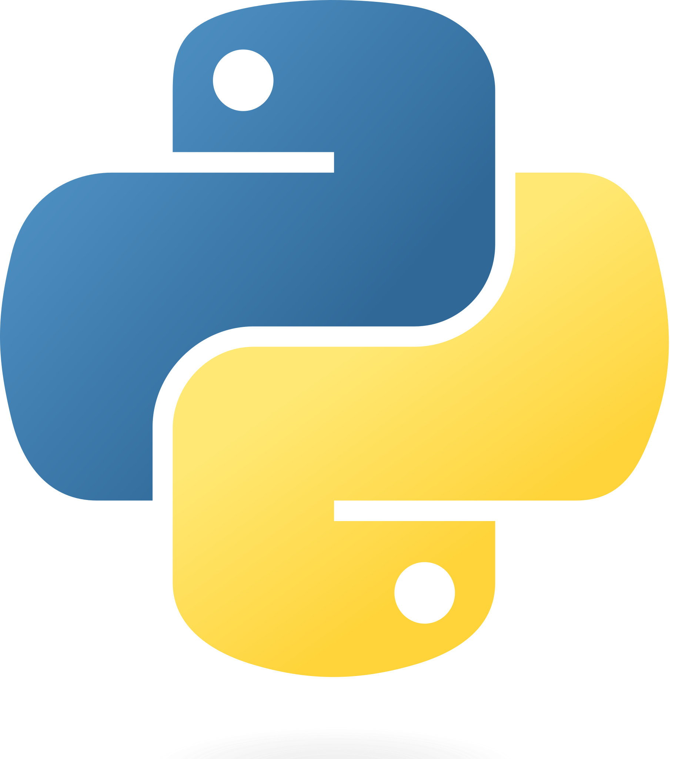
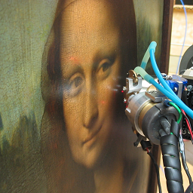
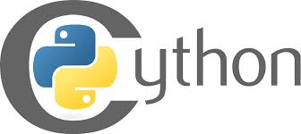
pyFAI: pythonic tool to reduce 2D patterns
Python as the most accessible and widespread programming language in science.
Developed and generally used at the ESRF:
Data acquisition (BLISS)
Data visualization (silx)
Data analysis (PyMCA)
PyFAI combines python API with fast algorithms written in Cython and OpenCL
Why pyFAI?

Slide 10
Alternatives to pyFAI
Fit2D
MIT licensed from ESRF, written in Fortran, now discontinued
XRDUA
GPL licensed from U. Antwerp, written in IDL, focuses on diffraction mapping
DAWN
EPL licensed from Diamond Light Source, written in Java
DataSqueeze
Freeware from U. Pennsylvania
Foxtrot
Commercial, from XENOCS & SOLEIL synchrotron, written in Java
MAUD
Freeware from U. Trento, written in Java
GSAS-II
Freeware tool from U. Chicago & APS, written in Python
Scikit-beam
BSD licensed from NSLS-II, written in Python

Slide 11
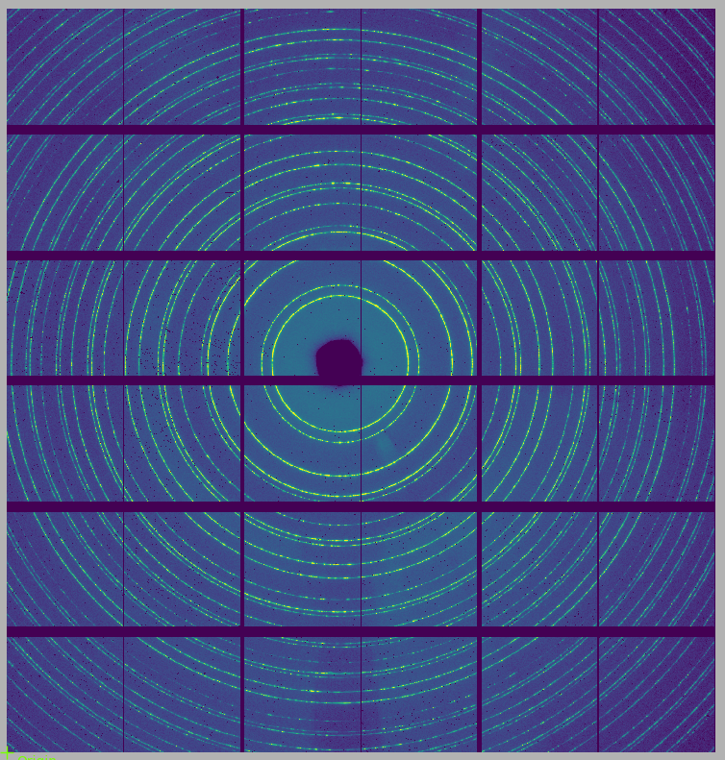
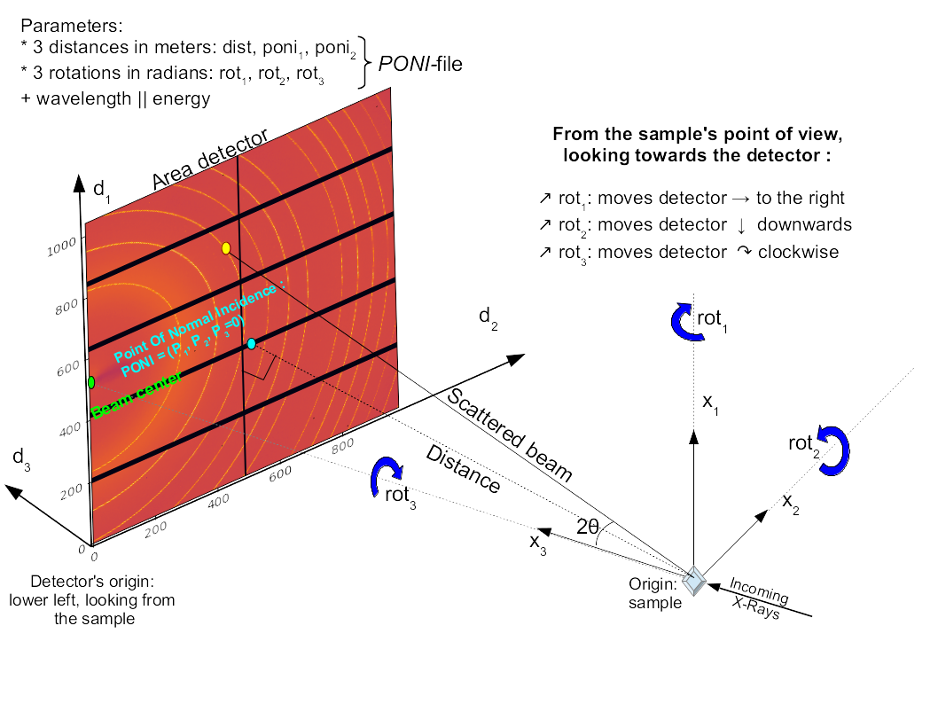
PyFAI: core concepts
Detector
detector_factory
Generic detector
Image / Frame / Pattern
Numpy 2D array
To be read using FabIO,
silx, h5py…
Geometry
X-ray wavelength
Position and rotations
of the detector
Integrator
Takes the detector and geometry
Takes the image
Performs the integration

Slide 12
PyFAI: core concepts
Detector
detector_factory
Generic detector
Image / Frame / Pattern
Numpy 2D array
To be read using FabIO,
silx, h5py…
Geometry
X-ray wavelength
Position and rotations
of the detector
Integrator
Takes the detector and geometry
Takes the image
Performs the integration

Slide 13
PyFAI: core concepts
Detector
detector_factory
Generic detector
Image / Frame / Pattern
Numpy 2D array
To be read using FabIO,
silx, h5py…
Geometry
X-ray wavelength
Position and rotations
of the detector
Integrator
Takes the detector and geometry
Takes the image
Performs the integration

Slide 14
PyFAI: core concepts
Detector
detector_factory
Generic detector
Image / Frame / Pattern
Numpy 2D array
To be read using FabIO,
silx, h5py…
Geometry
X-ray wavelength
Position and rotations
of the detector
Integrator
Takes the detector and geometry
Takes the image
Performs the integration

Slide 15
PyFAI: core concepts
Detector
detector_factory
Generic detector
Image / Frame / Pattern
Numpy 2D array
To be read using FabIO,
silx, h5py…
Geometry
X-ray wavelength
Position and rotations
of the detector
Integrator
Takes the detector and geometry
Takes the image
Performs the integration

Slide 16
PyFAI: core concepts
Integrator
Detector
Geometry

Slide 17
PyFAI: core concepts
Integrator
RAW DATA
Detector
Geometry

Slide 18
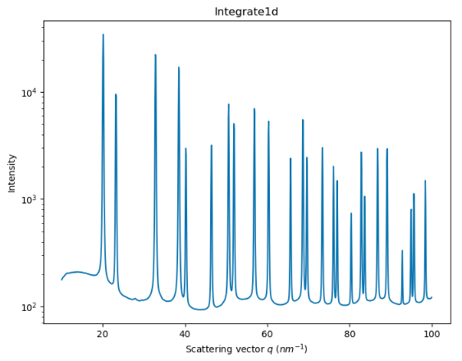
PyFAI: core concepts
Integrator
RAW DATA
PROCESSED DATA
Detector
Geometry

Slide 19
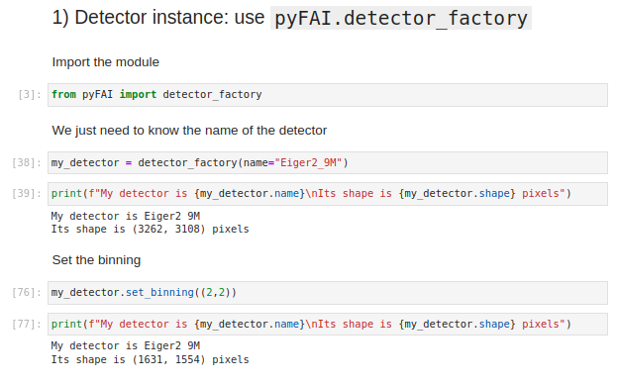
Detector instance
Import detector from detector_factory (e.g. Pilatus1M from Dectris)

Slide 20
Detector instance
Import detector from detector_factory (e.g. Pilatus1M from Dectris)
Detector information:
Pixel size 1
Pixel size 2
Binning: default (1,1)
Max_shape
Orientation (1→4)

Slide 21
Detector instance
Import detector from detector_factory (e.g. Pilatus1M from Dectris)
Detector information:
Pixel size 1
Pixel size 2
Binning: default (1,1)
Max_shape
Orientation (1→4)
Most of the time, by knowing the name of your detector is enough!

Slide 22
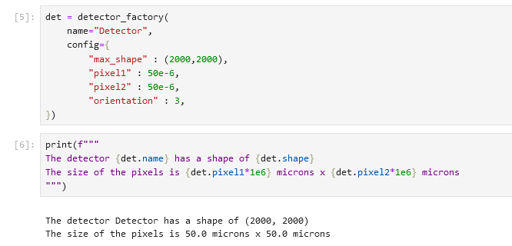
Detector instance
Import detector from detector_factory (e.g. Pilatus1M from Dectris)
Customized (generic) detector
Detector information:
Pixel size 1
Pixel size 2
Binning: default (1,1)
Max_shape
Orientation (1→4)
Normally, this step is skipped as it is done through the calibration graphical interface
Bet: > 50% pyFAI crashes are related to wrong detector shapes

Slide 23
Geometry instance
A geometry is fully defined by:
A detector instance
Sample to detector distance (in meters)
Wavelength of the beam (in meters)
Three rotations of the detector
Coordinates of the point of normal incidence (PONI), from the sample to the detector plane.
Normally, the calibration of the geometry is fully done through the graphical interface.

Slide 24
Calibration of geometry: pyFAI-calib2
Calibration is made after measuring a standard sample:
LaB6, Cr2O3, AgBh…
Choosing the correct detector (+ orientation, binning, mask…)
Selecting the Debye-Scherrer rings associated to the standard
Fitting the rings
Refinement
Validation
Saving of .poni file
.poni file

Slide 25
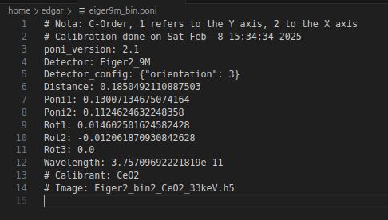
Calibration of geometry: pyFAI-calib2
Calibration is made after measuring a standard sample:
LaB6, Cr2O3, AgBh…
Choosing the correct detector (+ orientation, binning, mask…)
Selecting the Debye-Scherrer rings associated to the standard
Fitting the rings
Refinement
Validation
Saving of .poni file
.poni file

Slide 26
PyFAI: creating an integrator
Integrator
Detector
Geometry

Slide 27
PyFAI: creating an integrator
Integrator

Slide 28
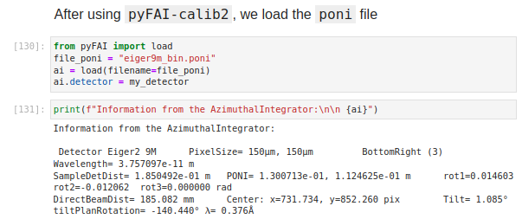
PyFAI: creating an integrator
Integrator

Slide 29
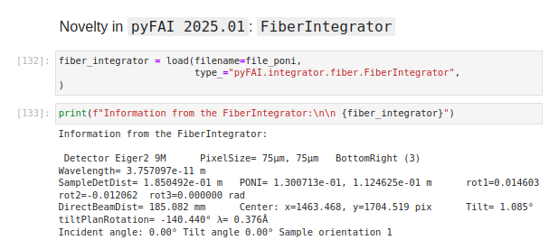
PyFAI: creating an integrator
Integrator
*FiberIntegrator is targeted to Grazing Incidence experiments

Slide 30
PyFAI: loading data
Integrator
RAW DATA

Slide 31
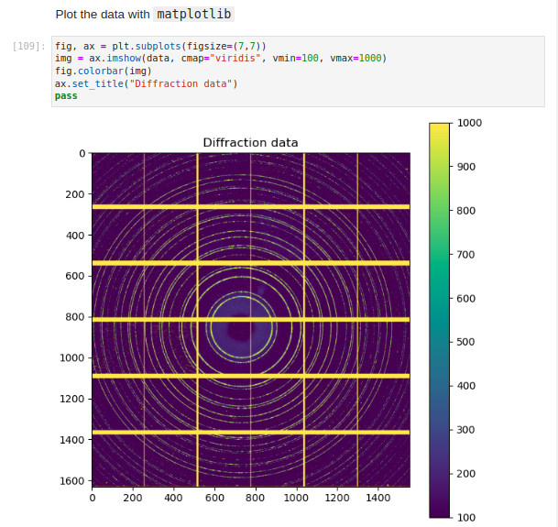
PyFAI: loading data
Importing data is made through other python packages:
FabIO
Silx
h5py
Common file formats:
.edf
.tiff
.h5
Visualizing is made through:
matplotlib
seaborn
silx

Slide 32
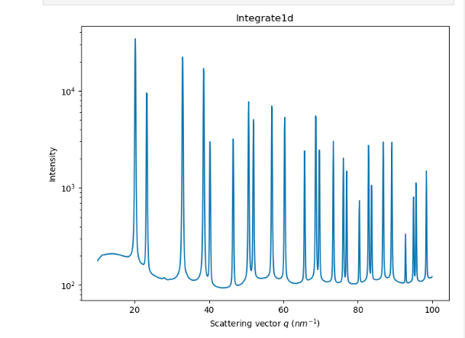
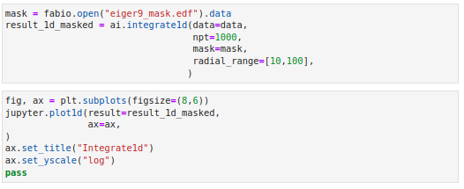
PyFAI: loading data
RAW DATA
integrate1d
Integrator

Slide 33
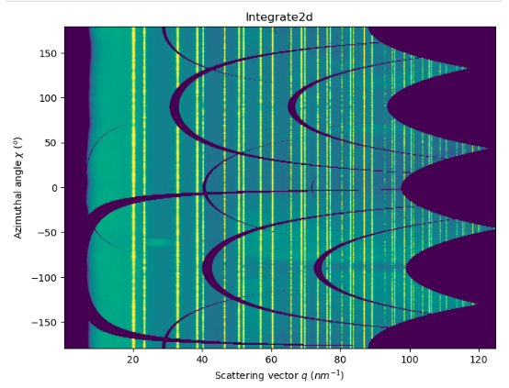
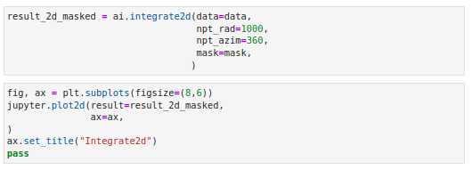
PyFAI: loading data
RAW DATA
integrate2d
Integrator

Slide 34
What happens during an integration
1) Get the coordinates of every corner of every pixel of the detector (in meters).
3 coordinates per corner, 4 corners per pixel
Detector of 1000x1000 = 10⁶ pixels = 1Mpix * 4 (corners) * 3 (coordinates) * 4 (bytes) = 48 Mbytes
2) Offset the detector’s origin to the PONI and rotate around the sample.
3) Calculate the radial (2theta) and azimuthal (chi) positions of each corner.
4) Calculate normalization matrix: polarization, solid-angle, flat-field...
5) Assign each pixel to one or multiple bins.
6) Histogram bin position with associated intensities
7) Histogram bin position with associated normalizations
8) Return bin position and the ratio of sum of intensities / sum of norm.

Slide 35
Integration algorithms
Histogram
Pixel by pixel procedure.
Each pixel is split over the bins it covers.
Corner coordinates have to be calculated (4x slower initialization).
The slow down is function of the oversampling factor, for every image.
Serial read → Random write
Sparse Matrix Multiplication
Bin by bin procedure.
Creates and stores a sparse matrix with all the integration information.
The sparse matrix can be huge: longer initialization related to the oversampling factor.
No performance penalty on the integration itself.
Serial write ← Random read

Slide 36
Pixel splitting
No splitting: one pixel to one single bin upon in which bin the center of the pixel is falling.
Bin (k+1)
Bin (k)
Bin (k-1)
The intensity of each bin is the sum of the intensity of the pixels whose center falls into the radius bin

Slide 37
Pixel splitting
Splitting: each pixel intensity is shared between consecutive bins.
*Full pixel splitting
Bin (k+1)
Bin (k)
Bin (k-1)
Each bin is the sum of the intensities of different pixels multiplied by a weight between 0.0 and 1.0

Slide 38
Implementation
Python
Use numpy methods
No initialization
Slow, no cache
Non-recommended (not popular)
Cython
Use cython methods
No initialization
Faster than python, no cache
Recommended to integrate 10s frames
OpenCL
Use parallelization through CPU/GPU
Initialization ~1-3 s
Cache
Potentially fast, depending on the GPU
Best option for large data

Slide 39
pyFAI interfaces
Applications:
GUI applications: pyFAI-calib2, pyFAI-integrate, pyFAI-diffmap-view
Batch mode: worker
Scriptable applications: pyFAI-average, pyFAI-saxs, pyFAI-waxs, diff_tomo
Python interface:
High level, direct API: scripts, Jupyter notebook
Mid level: manually creation of detectors, integrators, units…
Low level: manually setting the integrator engines
It is up to the user to choose the way he/she uses pyFAI

Slide 40
Latest news from pyFAI
PyFAI-2025.1.0: release on 31/01/2024
Median filter (cython, OpenCL)
Unified WorkerConfiguration
New API for Grazing Incidence experiments

Slide 41
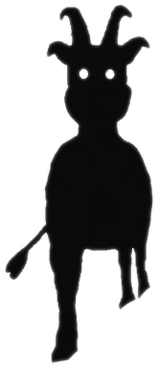
Project management: Silx & pyFAI
Compatible with Windows, MacOS, Linux
MIT licensed: compatible with both science and business
PyFAI is embedded in the silx-kit project: https://github.com/silx-kit/
Silx-kit project is python-based, developed at the ESRF and includes:
Open to collaborations:
About 20 direct contributors from ESRF, from other synchrotrons, XFELs (Soleil, NSLS-II, Petra-III, Eu-XFEL) and companies (Xenocs)
Used by ~90 other projects from many other X-ray sources in the world (SLAC, ALS, APS, ALBA, NSLS-II, Petra-III, Soleil, Diamond, SLS, MaxIV...)

Slide 42
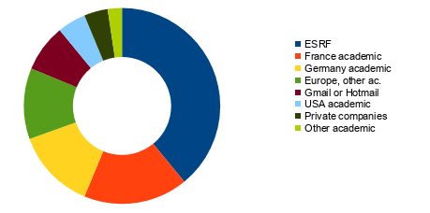
pyFAI user community
PyFAI is used in most European and American synchrotrons/FELs
User support is provided via the mailing list: pyFAI@esrf.fr (185 subscribers)
Bugs are discussed via Github issue tracker
https://github.com/silx-kit/pyFAI/issues

Slide 43
Reasons to choose pyFAI
Faster than others
First tool using sparse matrix multiplication to perform integration
All computation intensive kernels are ported to C, C++ or OpenCL
PyFAI is the only azimuthal integration tool benefiting from GPU
Versatile (increasing with every version)
Wide space to vary the integration protocol
Generic geometry
Most detectors already defined (+ custom detector through Nexus file)
Graphical user interface alternatives (thanks to Valentin Valls)

Slide 44
Acknowledgements
Main author: Jerome Kieffer
Contributors: 43
Former data analysis unit colleagues:
Valentin Valls
Loic Huder
Thomas Vincent
Claudio Ferrero
ESRF Beamlines:
BM01, BM02, ID02, ID11, ID13, ID15a, ID15b, ID21, ID22, ID23, BM26, ID27, BM28, ID28, BM29, ID29, ID30, ID31...
Trainees:
Aurore Deschildre
Frederic Sulzmann
Guillaume Bonamis
Other synchrotron/labs
Soleil: Fred Picca
Clemens Prescher (Dioptas)
Sesame: Philipp Hans
NSLS-II, ALS, APS…
International Grants:
LinkSCEEM-2 grant:
Dimitris Karkoulis
Giannis Ashiotis
Zubair Nawaz

Slide 45
ESRF User Meeting 2025 PyFAI tutorial
Jérôme Kieffer
Edgar Gutiérrez Fernández
10/02/2025

